Slide 1
NYC Motor Vehicle Collision Exploratory Data Analysis Nanda Rajarathinam

Slide 2
Introduction
The NYC Vision Zero Action Plan is intended to help end traffic deaths and injuries on New York City streets
The objective of this analysis is to analyze the variables pertaining to the New York city motor vehicle collision data and visually represent the data to understand the overall trend and big picture regarding the fatalities and injuries over the last 4 years.
Research Questions
Is there a overall trend applicable to all the boroughs or are there exceptions observed within certain areas ? Does this trend hold good for the three categories of people involved in the collisions namely pedestrians, cyclists and motorists ?
What are the top 5 contributing factors that account for majority of the fatalities / injuries ? Is there a trend observed in those factors over years ?
Does the time of the day have any impact on the number of casualties ? Is there a spike in the number of fatalities during certain part of the day ?
Do the casualties vary significantly based on neighborhood / geographical location within the boroughs ?

Slide 3
About the dataset…
The dataset was sourced from NYC Open Data website hosted by the city of NY
~840,000 observations and 29 variables
Variables
"DATE" "TIME“ "BOROUGH" "ZIP.CODE" "LATITUDE" "LONGITUDE"
"LOCATION" "ON.STREET.NAME" "CROSS.STREET.NAME" "OFF.STREET.NAME" "NUMBER.OF.PERSONS.INJURED"
"NUMBER.OF.PERSONS.KILLED" "NUMBER.OF.PEDESTRIANS.INJURED" "NUMBER.OF.PEDESTRIANS.KILLED"
"NUMBER.OF.CYCLIST.INJURED" "NUMBER.OF.CYCLIST.KILLED" "NUMBER.OF.MOTORIST.INJURED" "NUMBER.OF.MOTORIST.KILLED"
"CONTRIBUTING.FACTOR.VEHICLE.1" "CONTRIBUTING.FACTOR.VEHICLE.2“ "CONTRIBUTING.FACTOR.VEHICLE.3"
"CONTRIBUTING.FACTOR.VEHICLE.4“ “CONTRIBUTING.FACTOR.VEHICLE.5" "UNIQUE.KEY" VEHICLE.TYPE.CODE.1"
"VEHICLE.TYPE.CODE.2" "VEHICLE.TYPE.CODE.3" "VEHICLE.TYPE.CODE.4" "VEHICLE.TYPE.CODE.5"

Slide 4
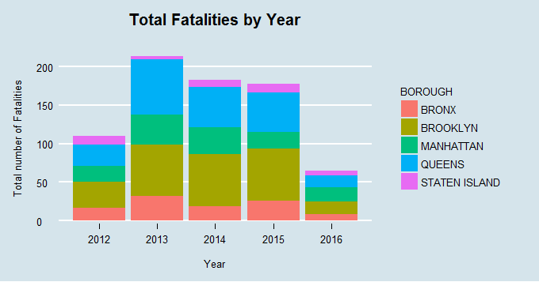
Total number of Fatalities by Year

Slide 5
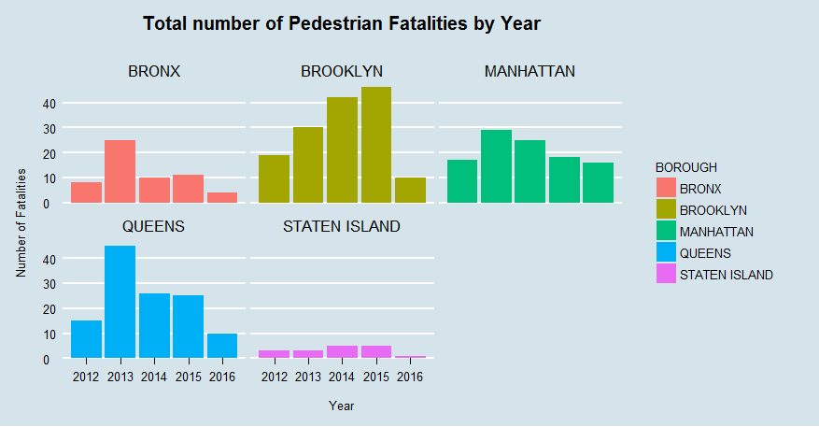
Total number of Pedestrian Fatalities by Year

Slide 6
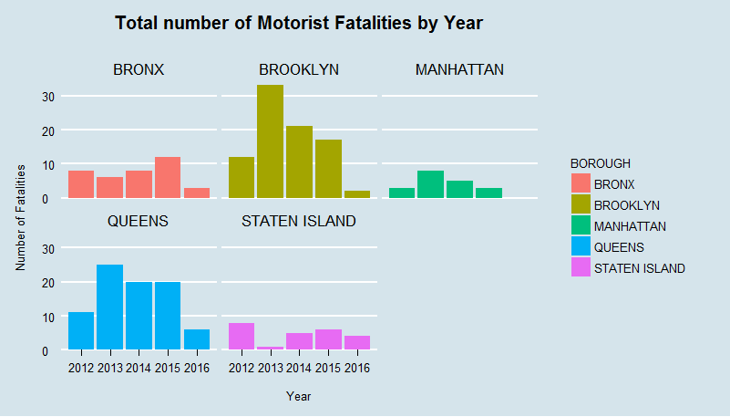
Total number of Motorist Fatalities by Year

Slide 7
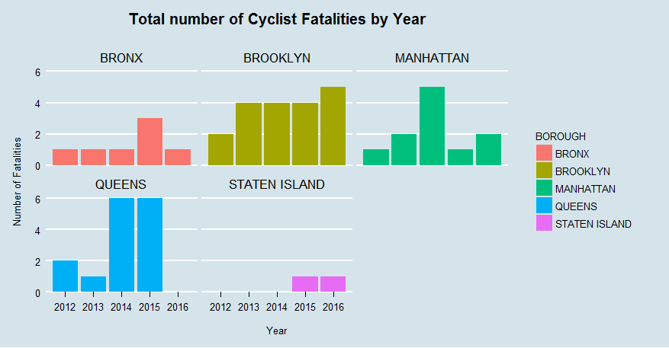
Total number of Cyclist Fatalities by Year

Slide 8
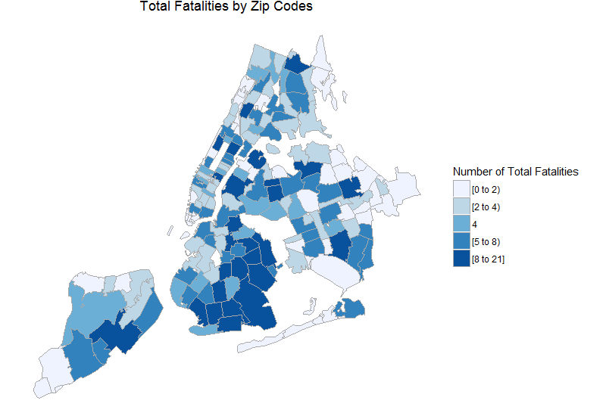
Total number of Casualties by ZIP code

Slide 9
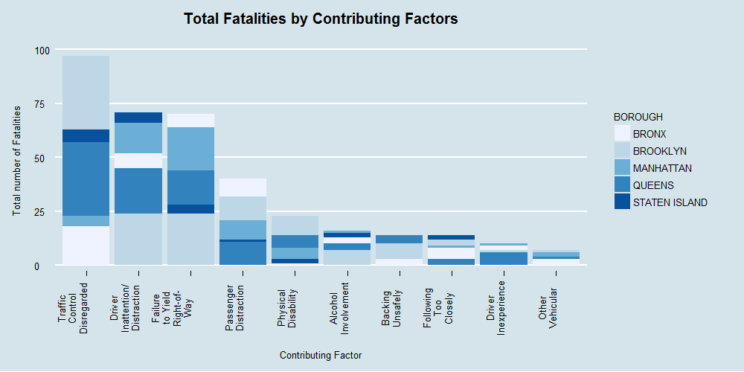
Total Fatalities by Contributing Factors

Slide 10
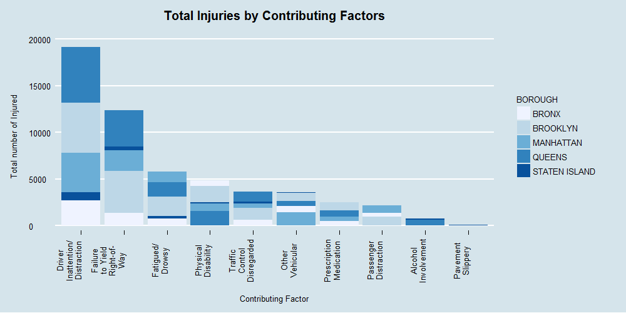
Total Injuries by Contributing Factors

Slide 11
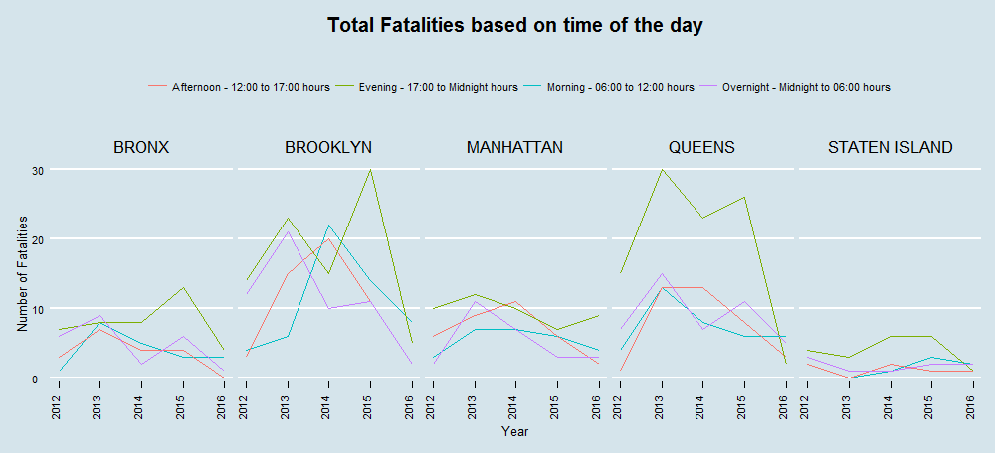
Total Fatalities based on Time of the day

Slide 12
Insights
Although the overall trend shows a decline in the number of motorist deaths in Brooklyn, Manhattan and Queens the trend seems to be rising in Bronx and Staten Island.
Regarding pedestrian casualties, Brooklyn seems to have an increasing trend in the number of pedestrian fatalities that is quite different from other boroughs.
Brooklyn and Queens have a higher number of cyclist related fatalities compared to other boroughs. This probably shows that NYPD and city officials might need to focus more on specific measures within certain boroughs aimed at improving safety of the target population.
The top factors that contributed towards the casualties were
Disregard for Traffic Control
Driver Inattention/Distraction
Failure to Yield Right-of-Way
Passenger Distraction
Alcohol Usage

Slide 13
Insights
Alcohol usage increases the chances of the collision being fatal than just causing bodily injuries. This can be observed from the higher rank of ‘alcohol usage’ factor in the Fatalities plot compared to Injuries plot
Most of the factors in the top 10 category show an overall declining trend except ‘Traffic control disregarded’ and ‘Following too closely’ which display a slightly erratic pattern over the years
The plot showed that there was a consistent observation in all boroughs where evening time(between 5 PM and mid-night) had the most number of casualties compared to rest of the day.
South eastern Brooklyn, Northern Bronx and southern Queens have the most number of fatalities and injuries compared to all other neighborhoods

